Slide 1


Slide 2
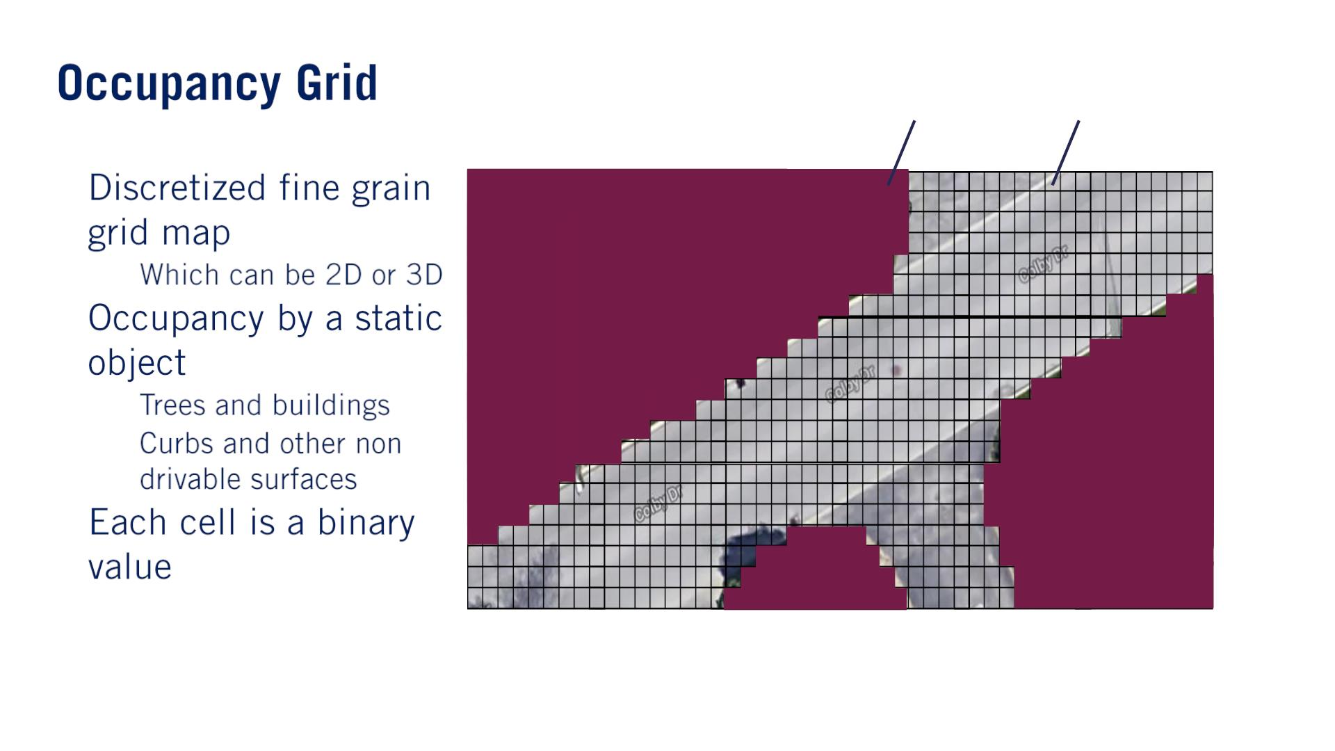
Occupied - 1 Free - 0
•
•
o
o
o
•
푚^{푖} ∈ {0,1}

Slide 3
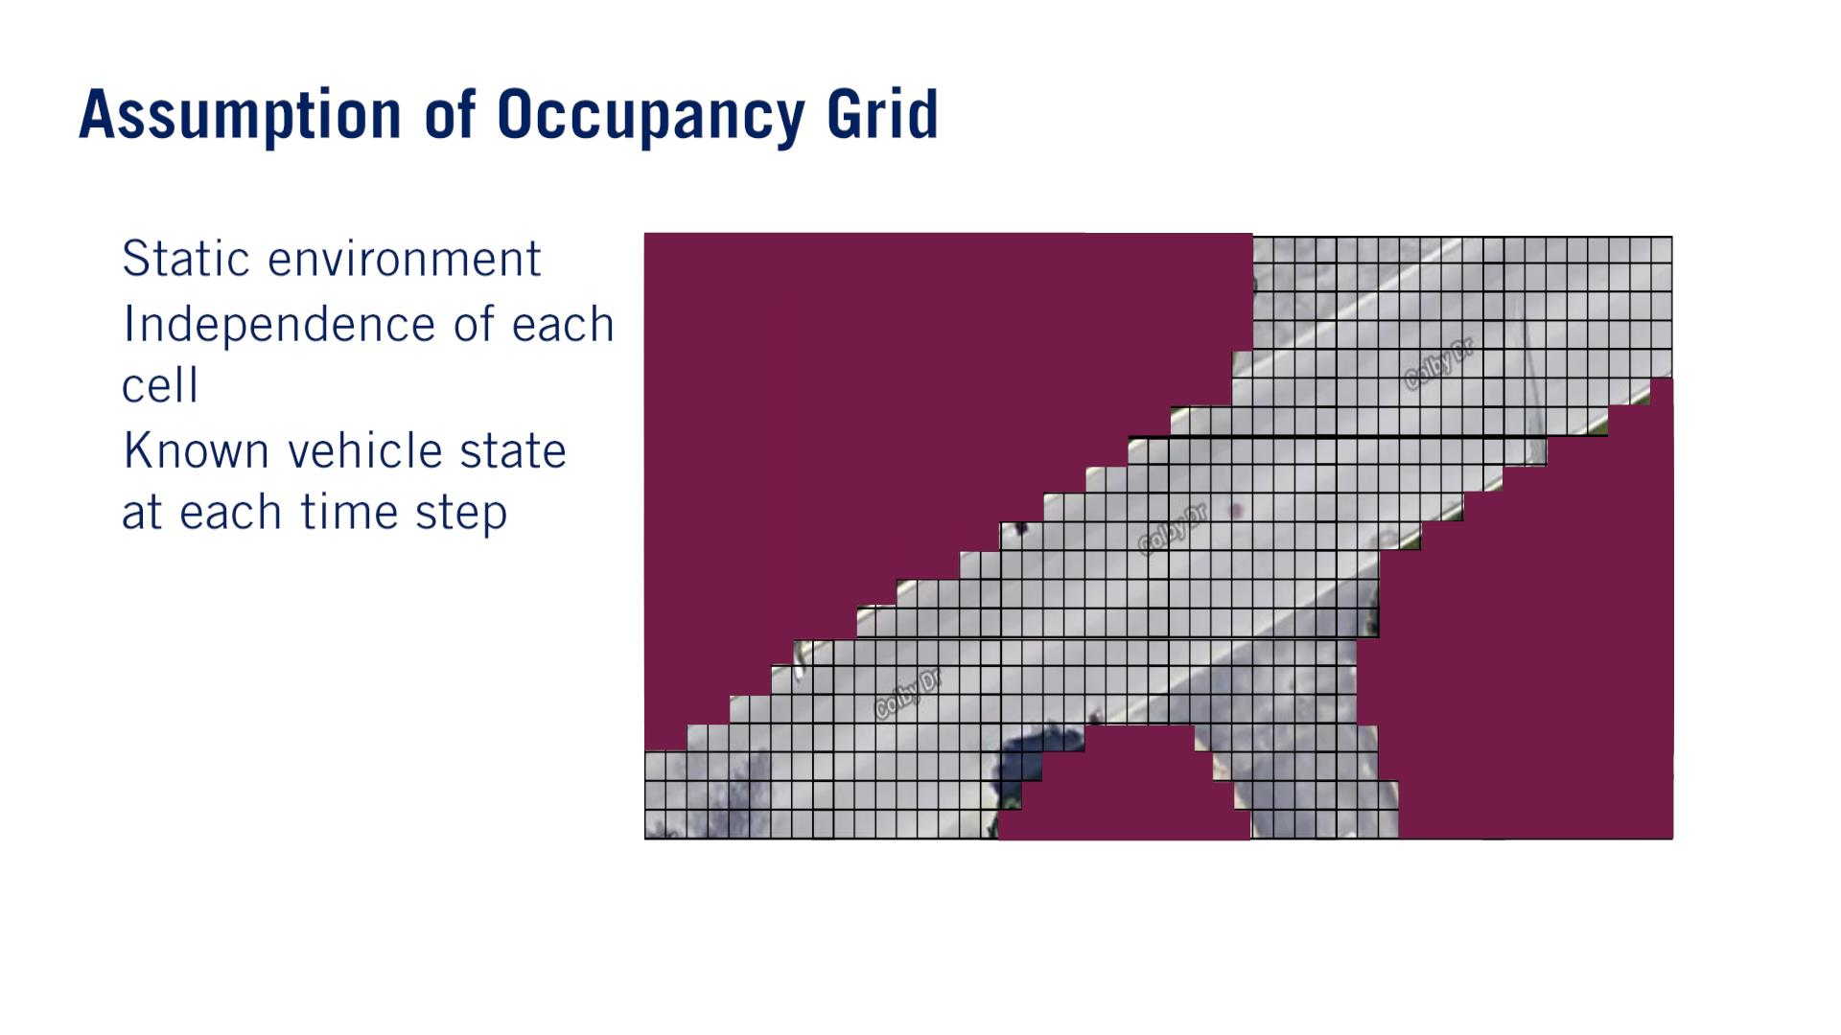
•
•
•

Slide 4
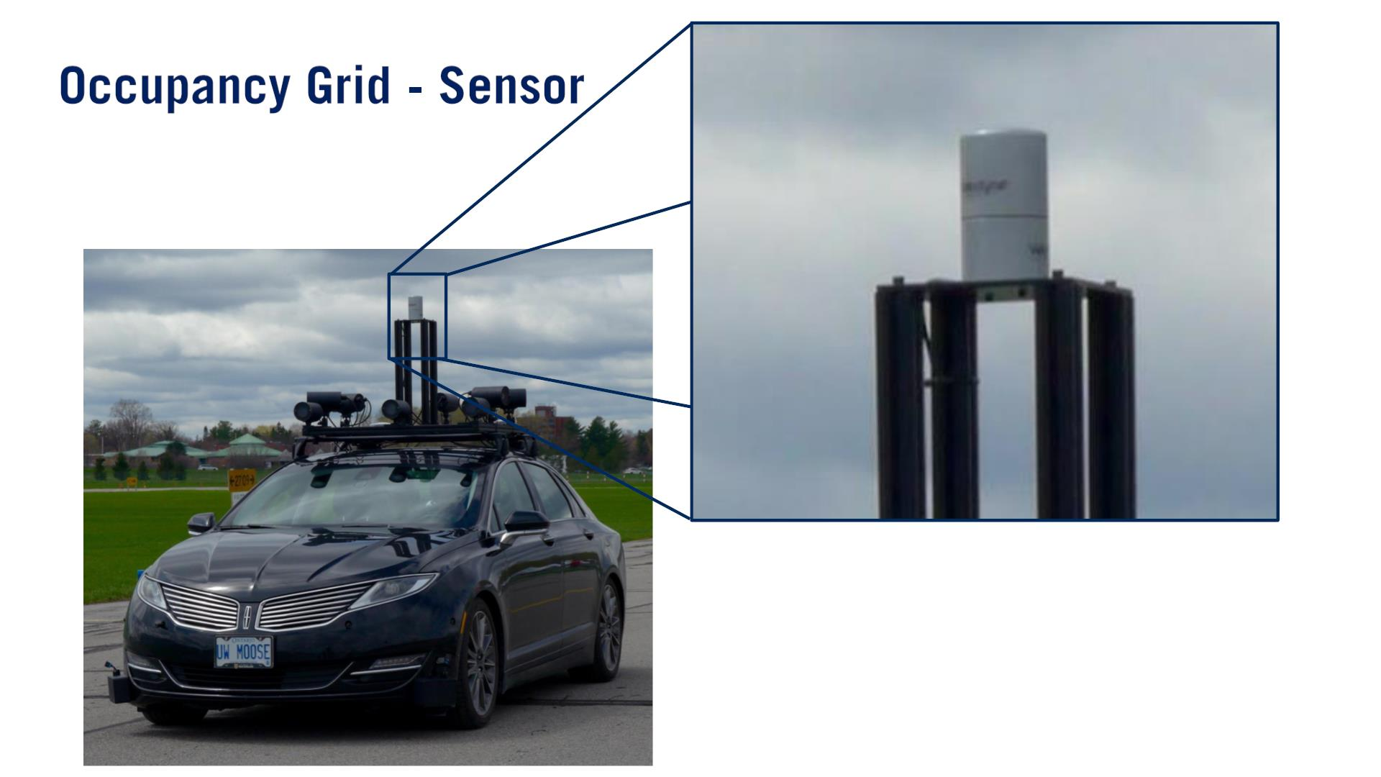

Slide 5
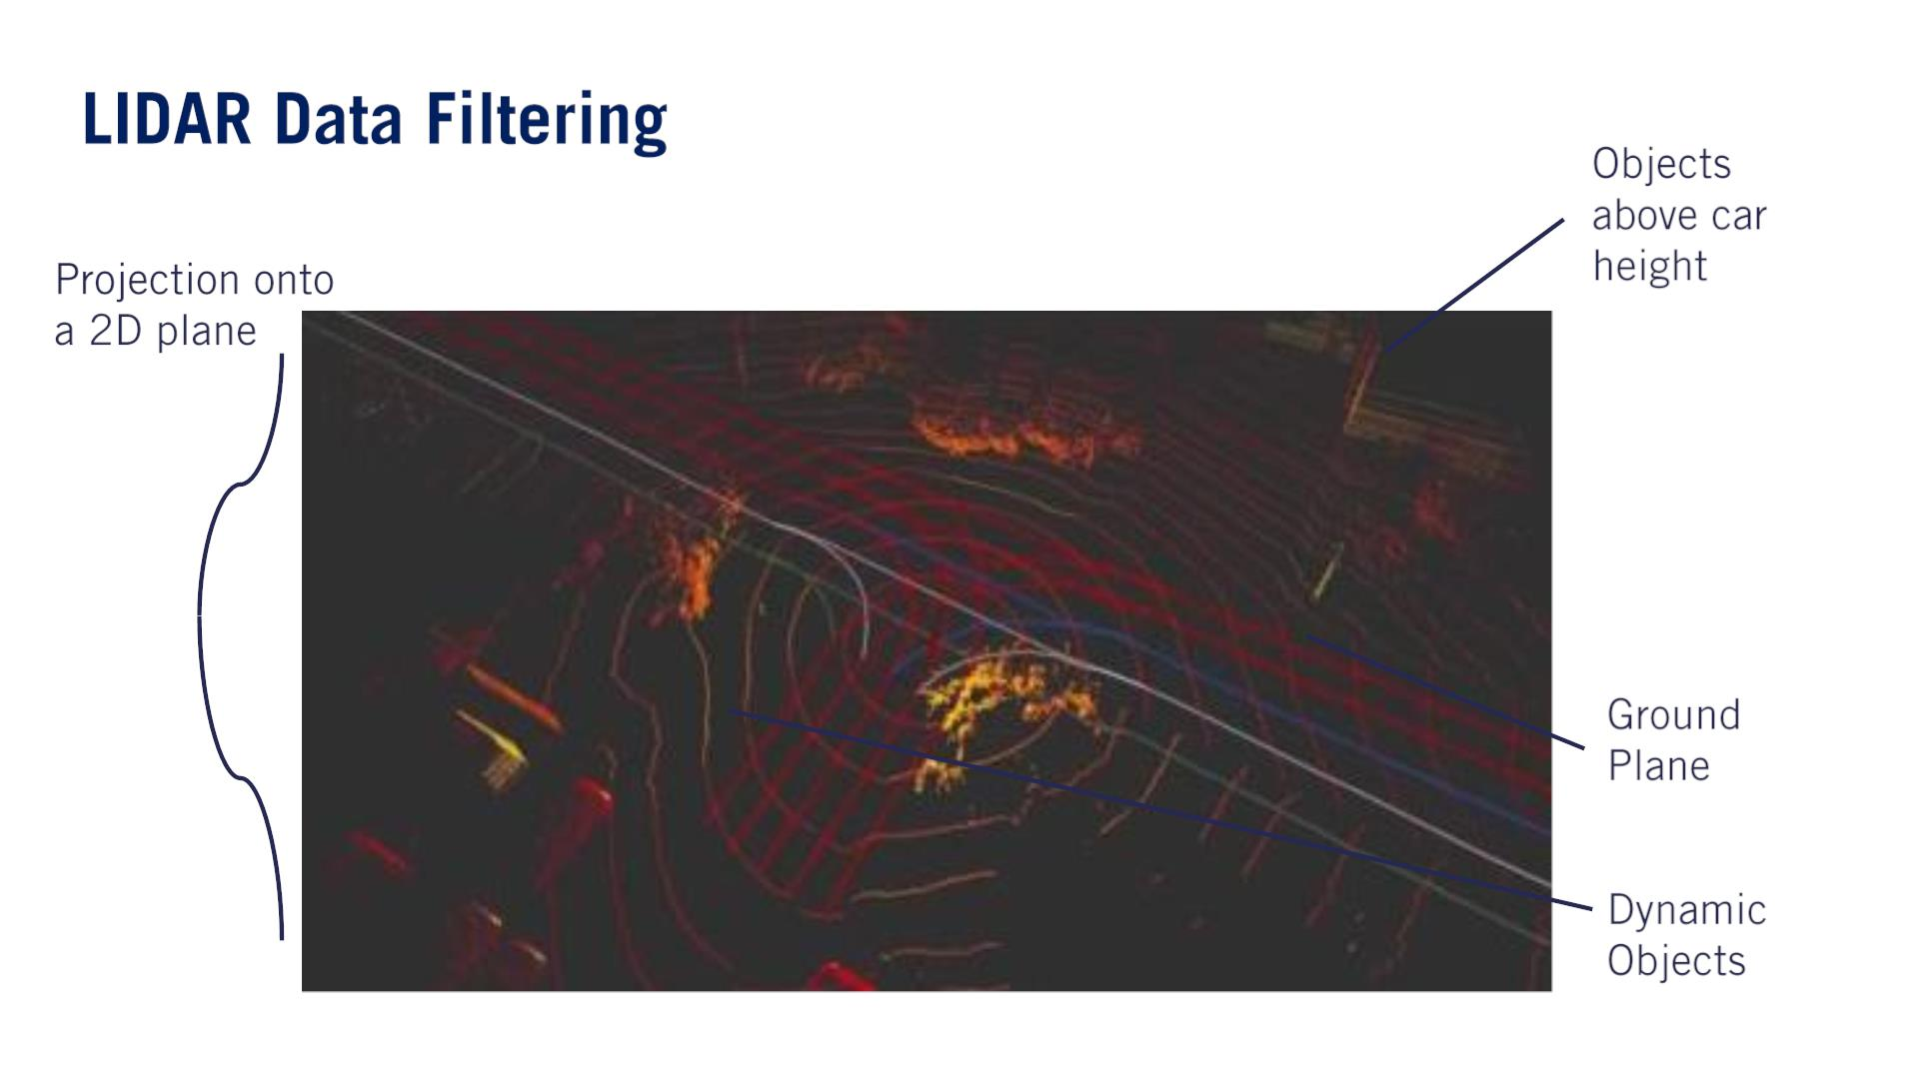
Several components of the LIDAR data need to be filtered out before this data can be used to construct an occupancy grid.
The first step is to filter all LIDAR points which comprise the ground plane.
Next, all points which appear above the highest point of the vehicle are also filtered out.
- Finally, all non-static objects which had been captured by the LIDAR need to be removed.

Slide 6
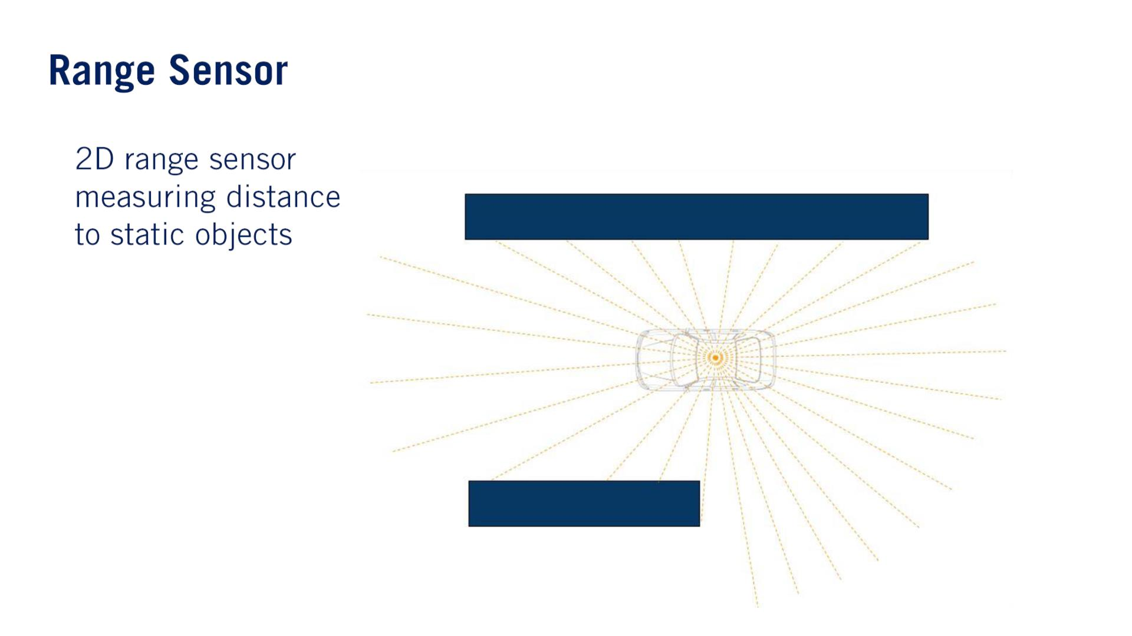
Projection onto a 2D plane. Range Sensorになっちゃう。
•

Slide 7
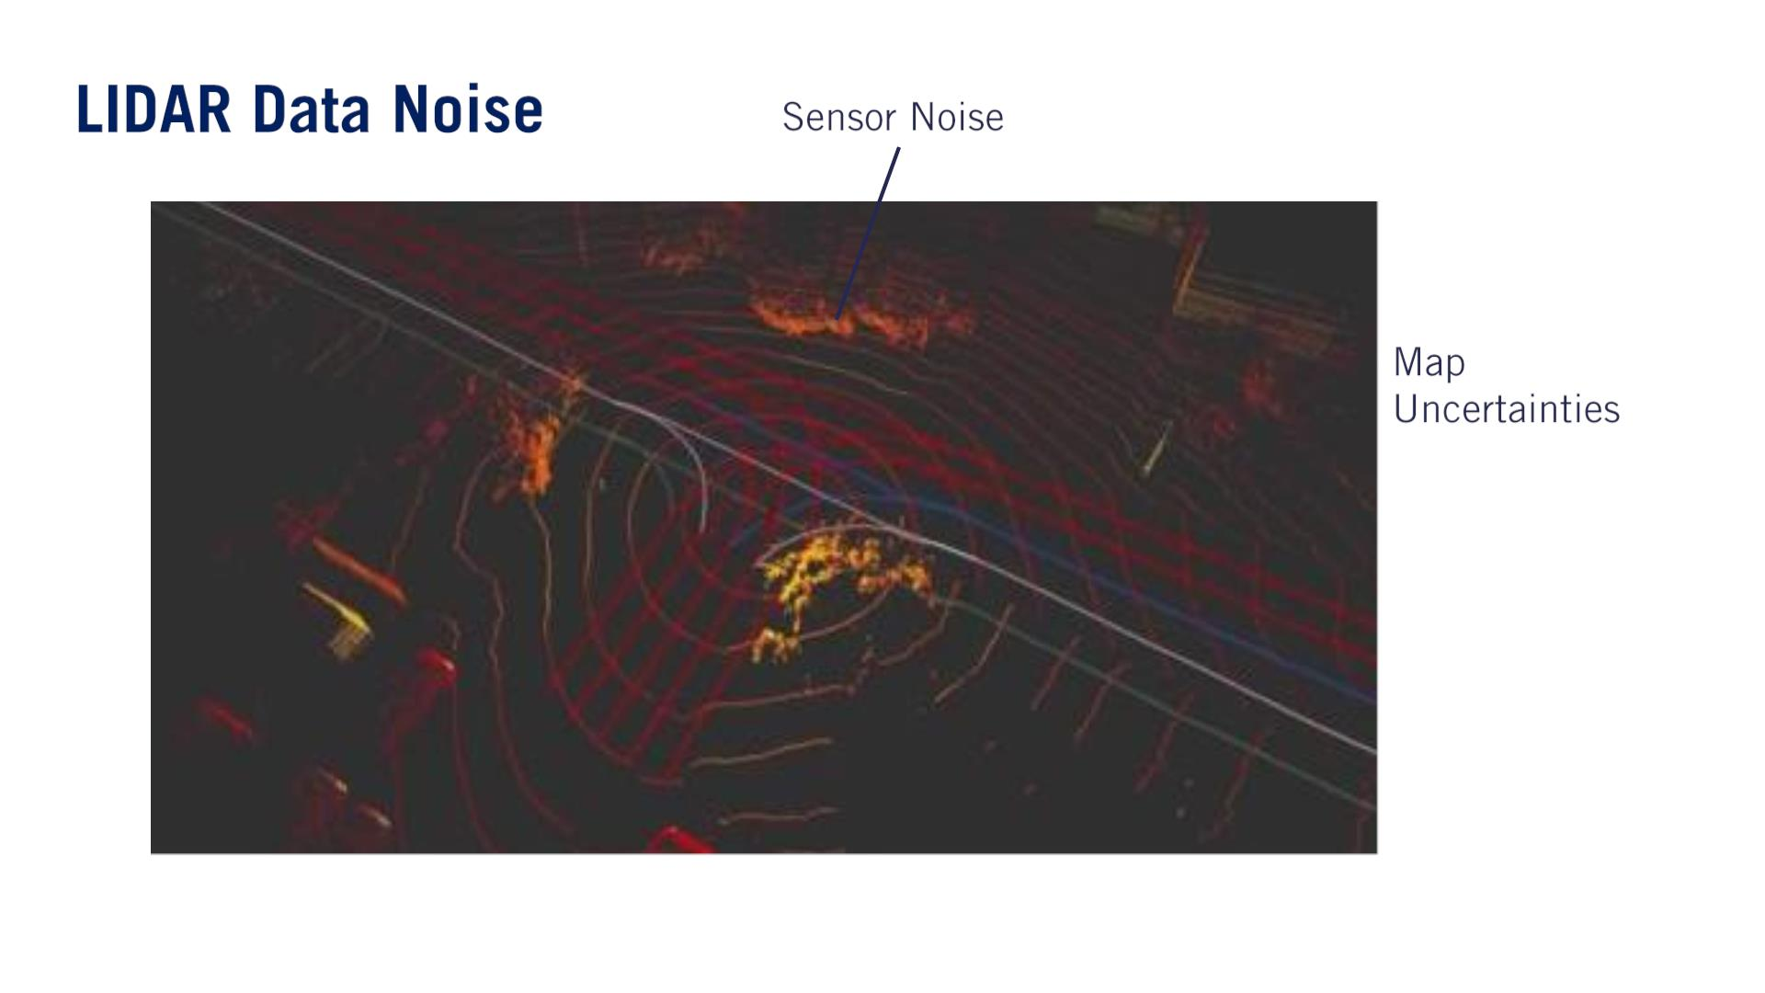
残る課題：LIDAR Data Noise.
- 解決策：Probabilistic Occupancy Grid.

Slide 8
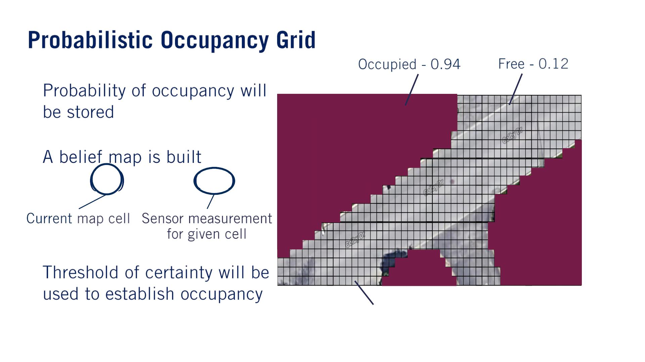
•
•
푚^{푖} ∈ {0,1}
푖
푖
푏푒푙 푚 = 푝(푚 | 푦, 푥 )
푡
•
푚^{푖}

Slide 9
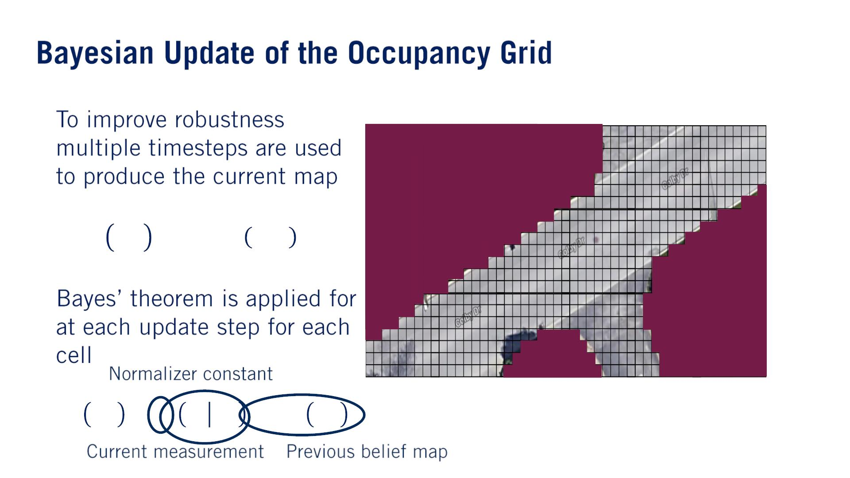

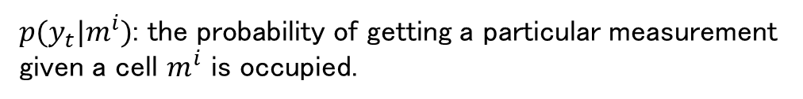
ベイズ
•
•
푖
푖
푏푒푙 푚 = 푝(푚 | 푦, 푥 )
푡
1:푡
$m^{i}$の値は結局binaryです。つまりoccupiedかどうか。
$p(y_{t}|m^{i})$: the probability of getting a particular measurement given a cell $m^{i}$ is occupied.
푖
푖
푖
푏푒푙 푚 = 휂푝 푦 푚 푏푒푙 푚
푡
푡
$$t−1$$
We rely on the Markov assumption, that all necessary information for estimating cell occupancy is captured in the belief map at each time step.

Slide 10
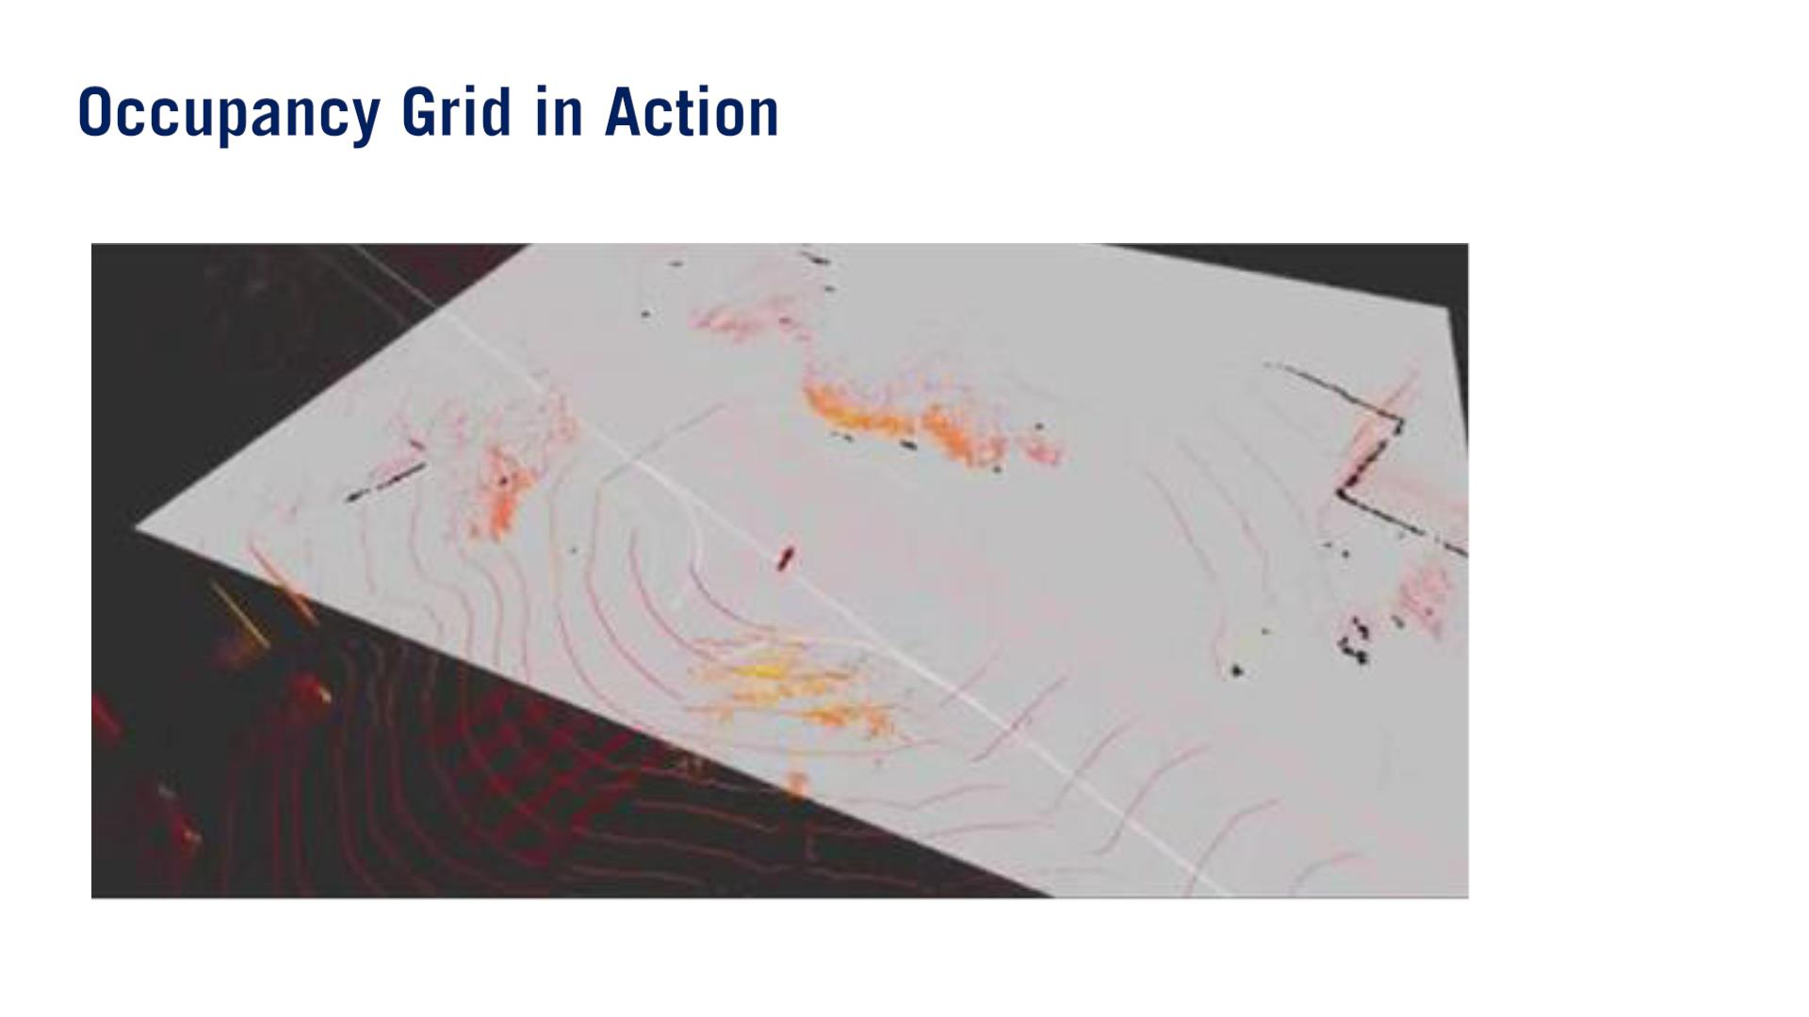

Slide 11
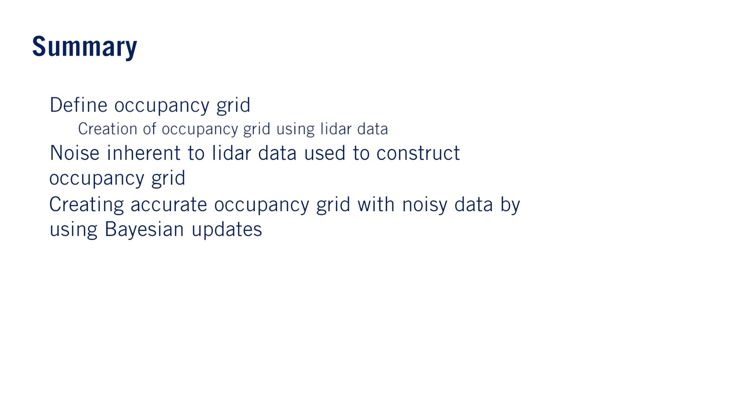
•
•
o
•

Slide 12

–

Slide 13
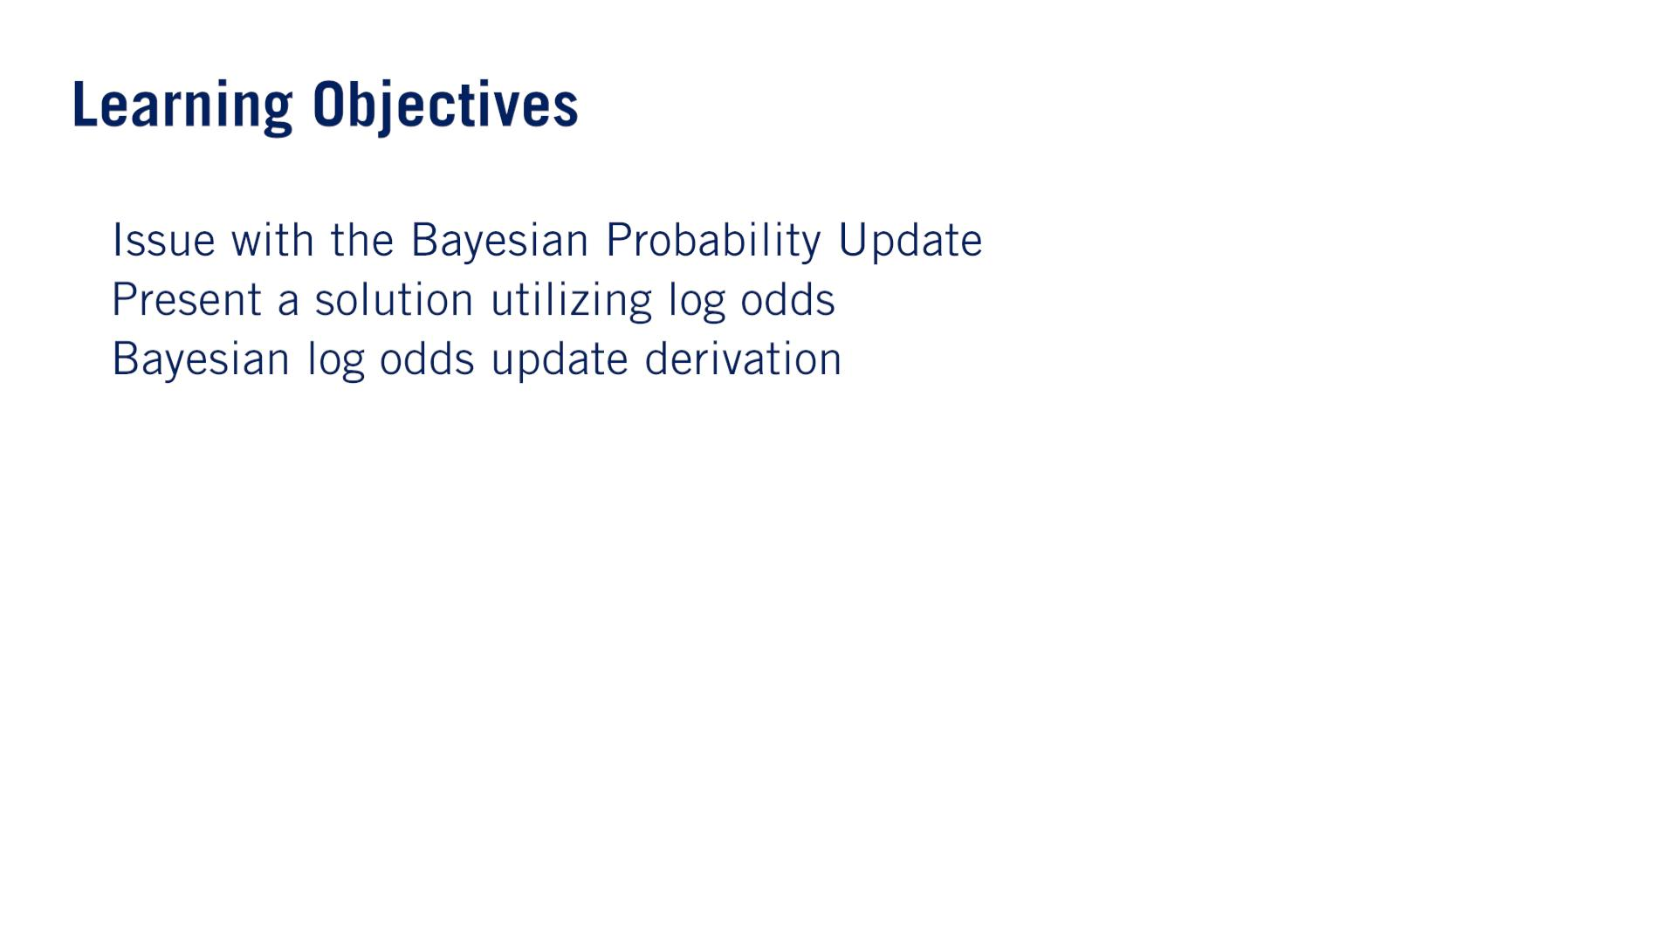
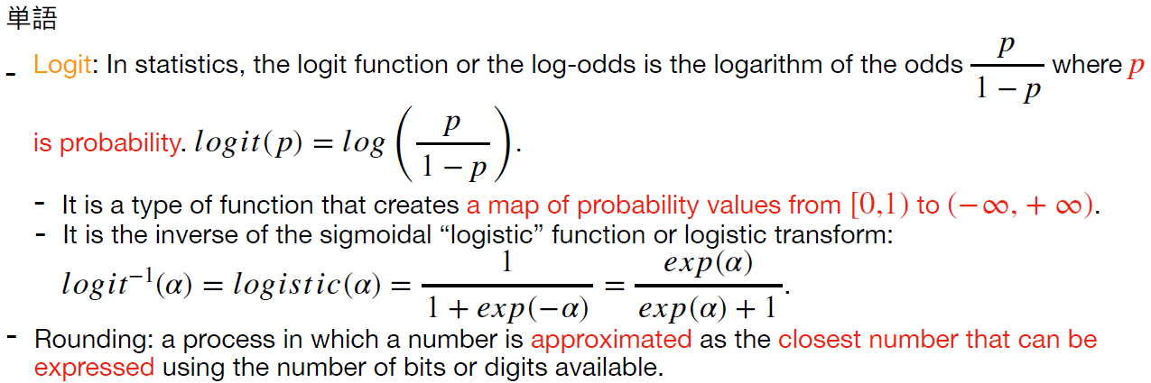
•
•
•
required to update the belief map.

Slide 14
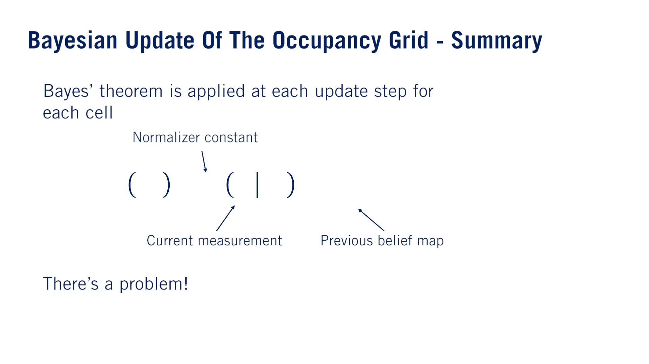

•
푖
푖
푖
푏푒푙 푚 = 푛푝 푦 푚 푏푒푙 (푚 )
푡
푡
$$t−1$$
•

Slide 15
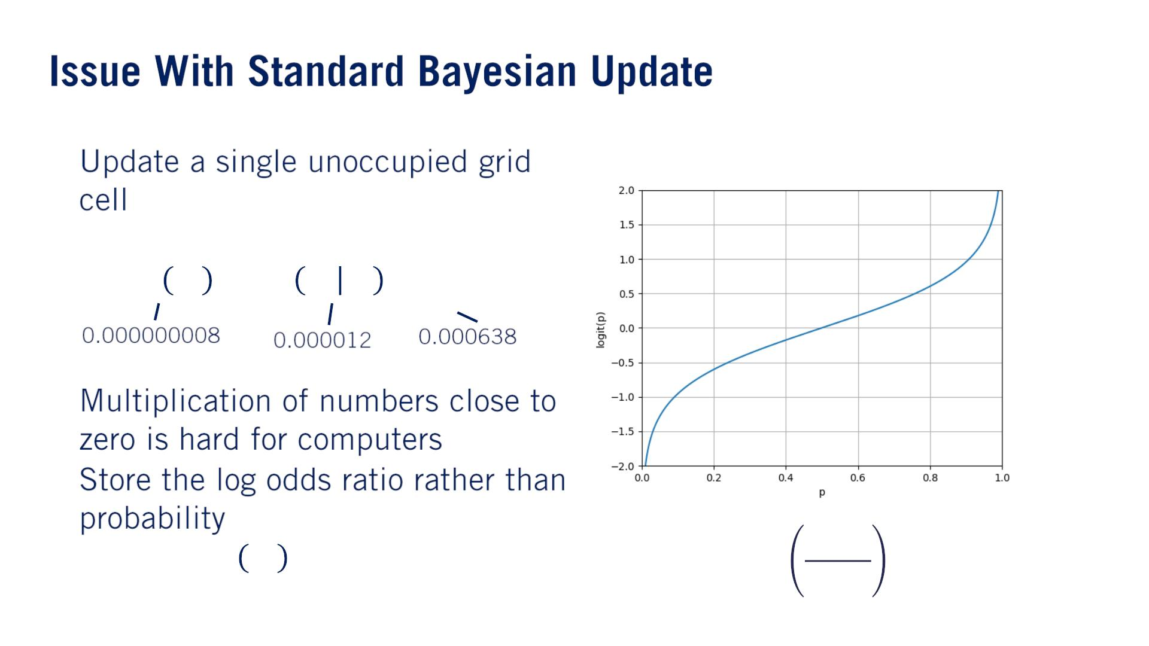


Multiplication of floating-point numbers on a computer can lead to significant rounding error (丸め誤差) when multiplying small numbers, which in turn can lead to instability in the estimate of the probabilities.
•
푏푒푙 푚 = 푛푝 푦 푚 푏푒푙 (푚)
푡
푡
$$t−1$$
•
•
by
푝
푏푒푙_{푡} 푚 → (−∞, ∞)
log
$$1−p$$

Slide 16
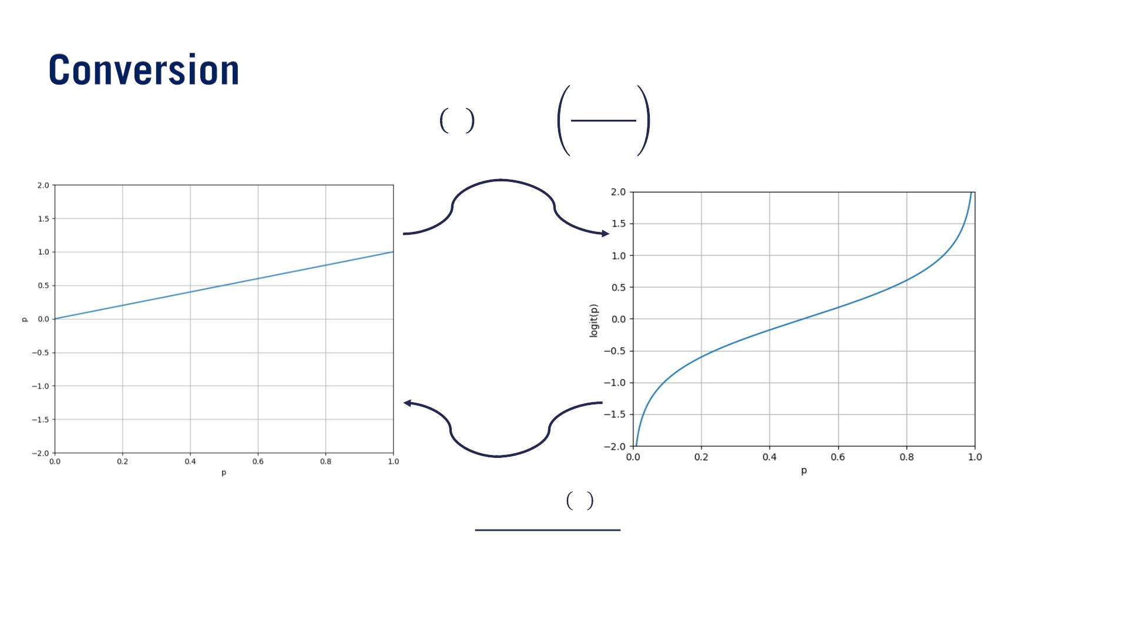

푝
푙표푔푖푡 푝 = log
$$1−p$$
_{푒}푙표푔푖푡 푝
_{1 + 푒}푙표푔푖푡(푝)
푝 =
つまりlogistic function

Slide 17
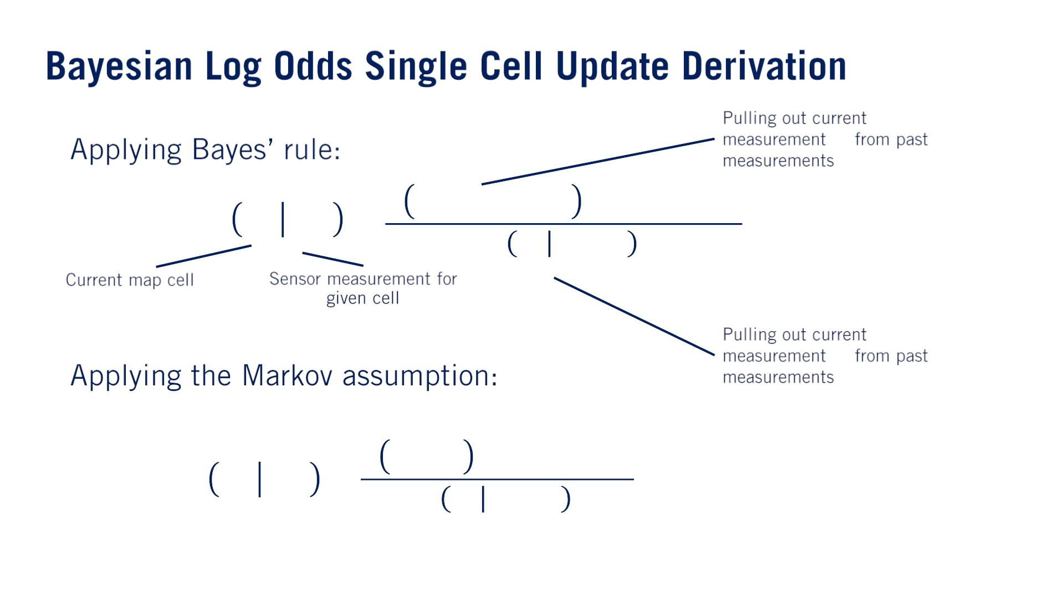


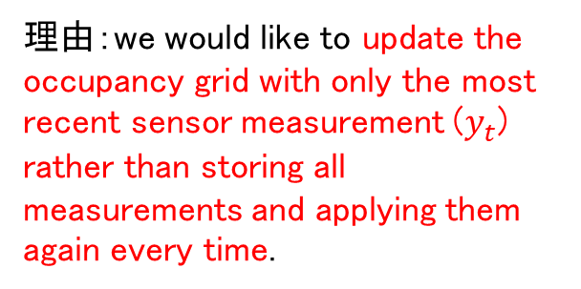



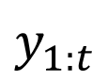
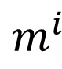



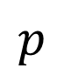

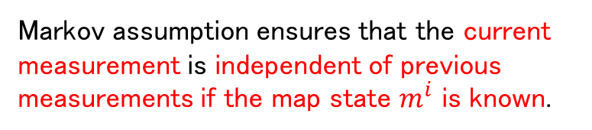



（⼤事）
証明は次のスライド
•
•
$$y_{t}$$
$$y_{1:t−1}$$
理由：we would like to update the occupancy grid with only the most recent sensor measurement ($y_{t}$) rather than storing all measurements and applying them again every time.
푖
푖
$$p$$
$$m^{i}$$
$$y_{1:t}$$
푝 푦 |푦 , 푚 푝(푚 |푦 )
=
$$t$$
$$1:t−1$$
$$1:t−1$$
푝 푦 푦
$$t$$
$$1:t−1$$
$$y_{t}$$
$$y_{1:t−1}$$
푖
푖
푝 푦 |푚 푝(푚 |푦 )
푖
푡
$$1:t−1$$
Markov assumption ensures that the current measurement is independent of previous measurements if the map state $m^{i}$ is known.
푝 푚 푦 =
1:푡
푝 푦 푦
$$t$$
$$1:t−1$$

Slide 18
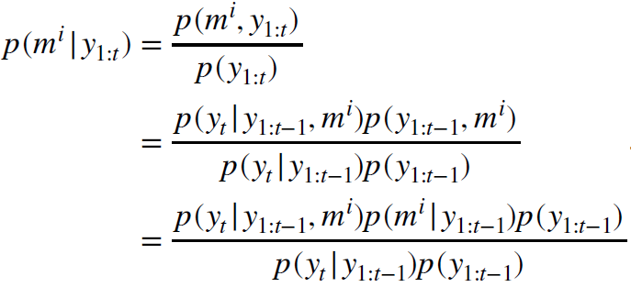
「Applying Bayes’ rule」ステップの証明：

Slide 19
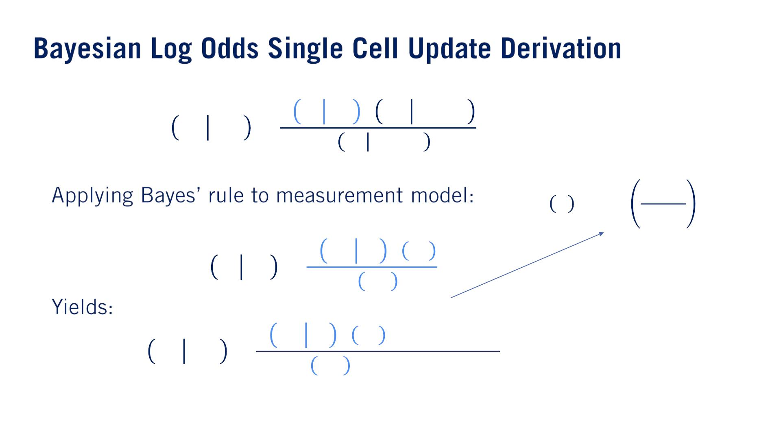

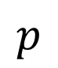
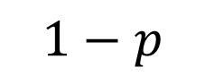

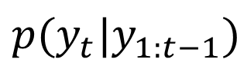

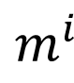

푖
푖
푝 푦 푚 푝 푚 푦
푖
푡
$$1:t−1$$
푝 푚 푦 =
1:푡
푝 푦 푦
$$t$$
$$1:t−1$$
•
•
푝
logit 푝 = log
$$1−p$$
푖
푝 푚 푦 푝 푦
푖
푡
푡
푝 푦 푚 =
푡
푝 푚^{푖}
푖
푖
푝 푚 푦 푝 푦 푝(푚 |푦 )
푖
푡
푡
$$1:t−1$$
푝 푚 푦 =
$$p$$
$$m^{i}$$
$$p(y_{t}|y_{1:t−1})$$
1:푡
푖

Slide 20
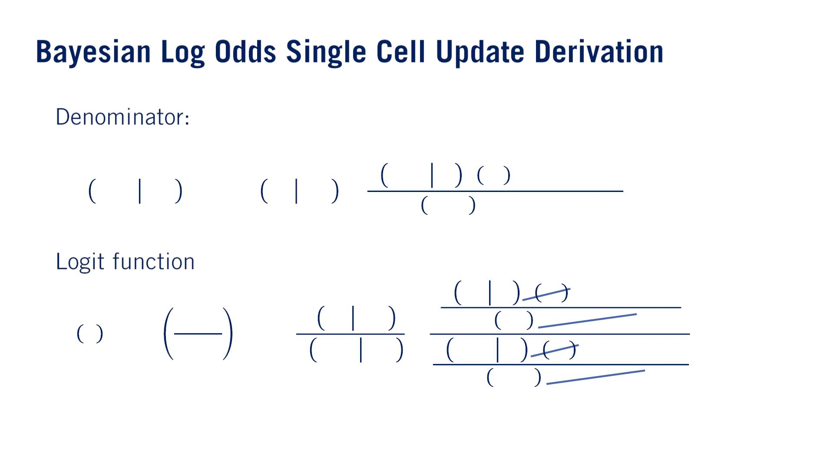
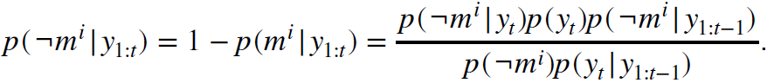
正しい式：
•
•
1 − 푝
Slidesの式は間違っている（でもその後のslideに修正された）。証拠：http://ais.informatik.uni-freiburg.de/teaching/ws17/mapping/pdf/slam10-gridmaps.pdf
元々のスライドの式：
푖
푖
푝 ¬푚 푦 푝 푦 푝(푚 |푦 )
푖
푖
푡
푡
1:푡‐1
푝 ¬푚 푦 = 1 - 푝 푚 푦 =
1:푡
1:푡
푖
푝 ¬푚 푝(푦 |푦 )
푡 1:푡‐1
푖
푖
푝 푚 푦 푝 푦 푝(푚 |푦 )
푡
푡
1:푡‐1
푝
푝 푚^{푖} 푦_{1:푡}
푖
푝 푚 푝(푦 |푦 )
logit 푝 = log
=
푡 1:푡‐1
1 － 푝
_{푝 ¬푚}푖 _{푦}
푖
푖
1:푡
푝 ¬푚 푦 푝 푦 푝(푚 |푦 )
푡
푡
1:푡‐1
푖
푝 ¬푚 푝(푦 |푦 )
푡 1:푡‐1

Slide 21
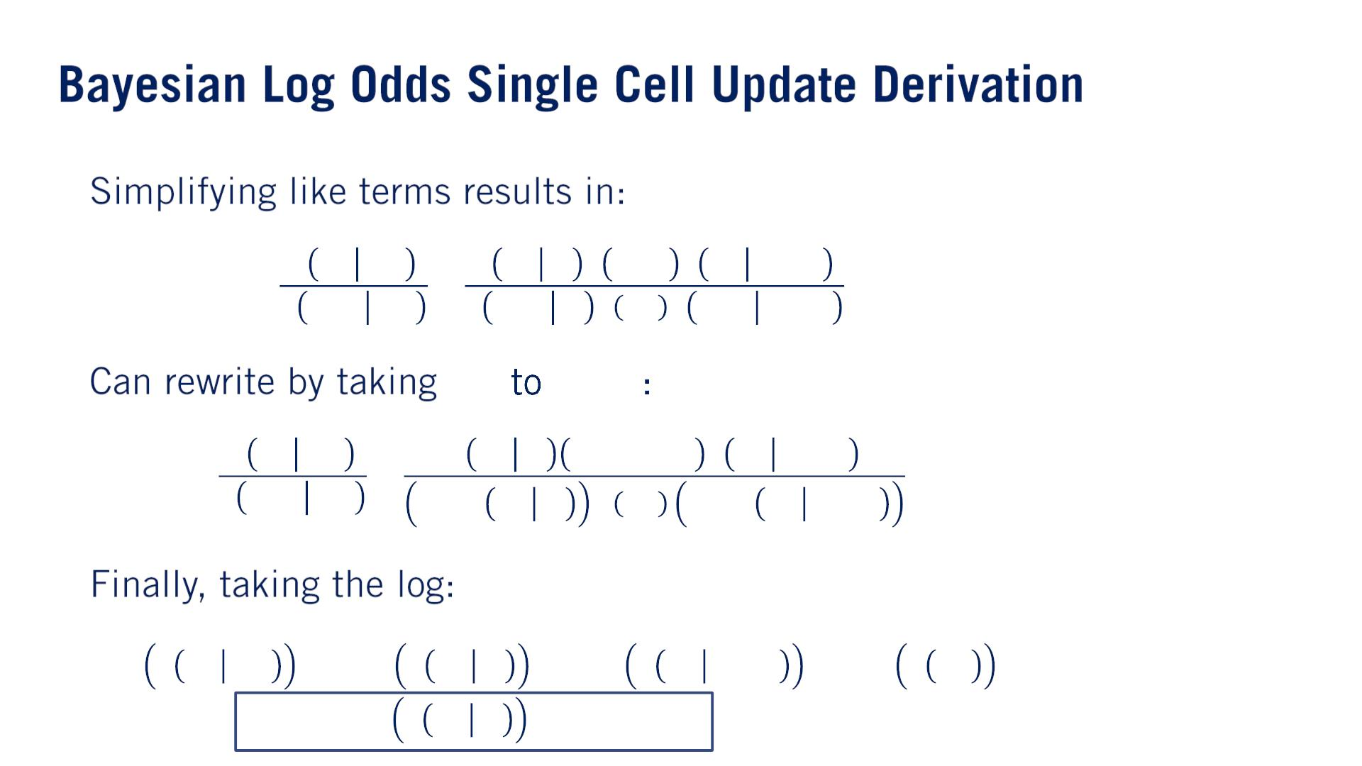
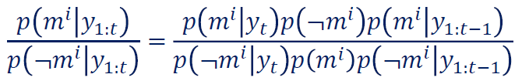
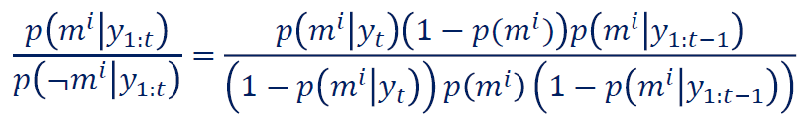
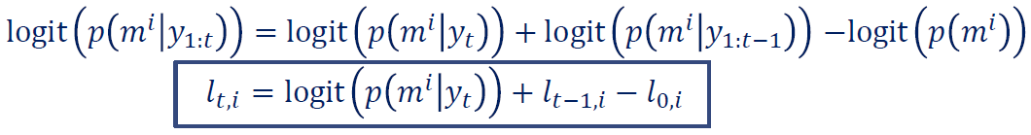
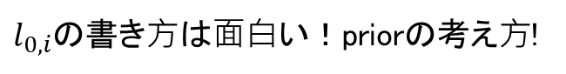
•
•
¬푝 1 － 푝
3つlogitになっている ！
•
$l_{0,i}$の書き⽅は⾯⽩い！priorの考え⽅!

Slide 22
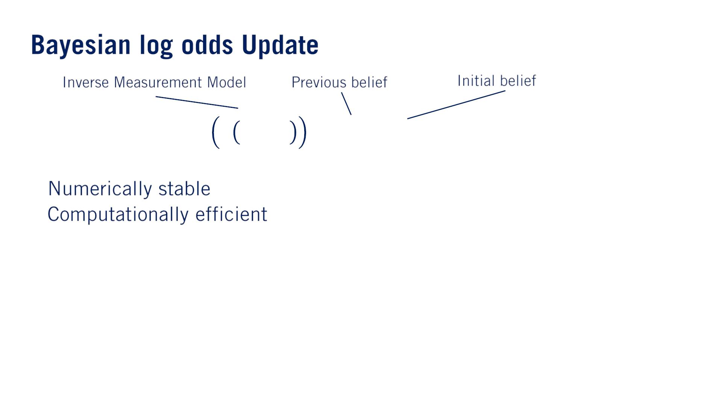
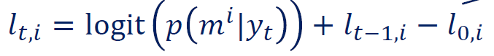
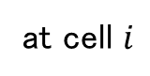

measurement modelは$p(y_{t}|m^{i})$だから！
at cell $i$
The initial belief represents the baseline belief that a grid cell is occupied, which is usually set to 50% uniformly.
It shows up in this equation at every time step, which is a bit surprising but is simply a result of the derivation and adjusts the addition of the first two terms to ensure the updated belief is consistent with the log odds form.
•
•
due to logit

Slide 23
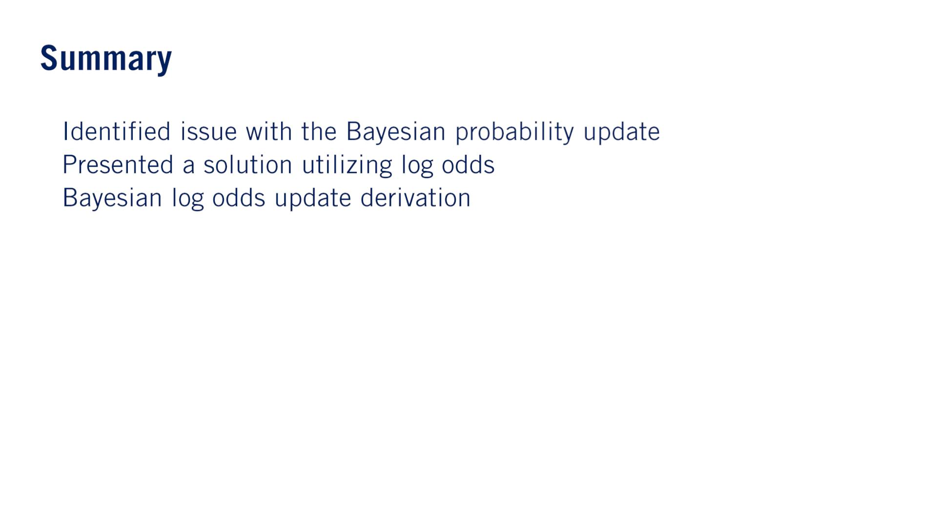
•
•
•

Slide 24

–

Slide 25
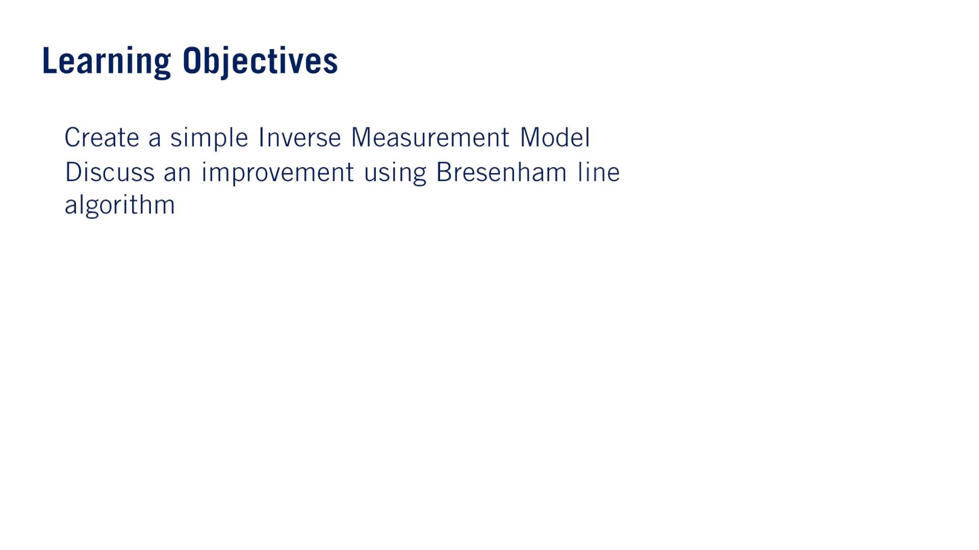
つまりmeasurementからgrid cellがoccupied確率を出せるmodel ！
•
•
ray tracing which will significantly reduce computational requirements for the inverse measurement model.
今回のLessonはちょっとミスが多いと思う。

Slide 26
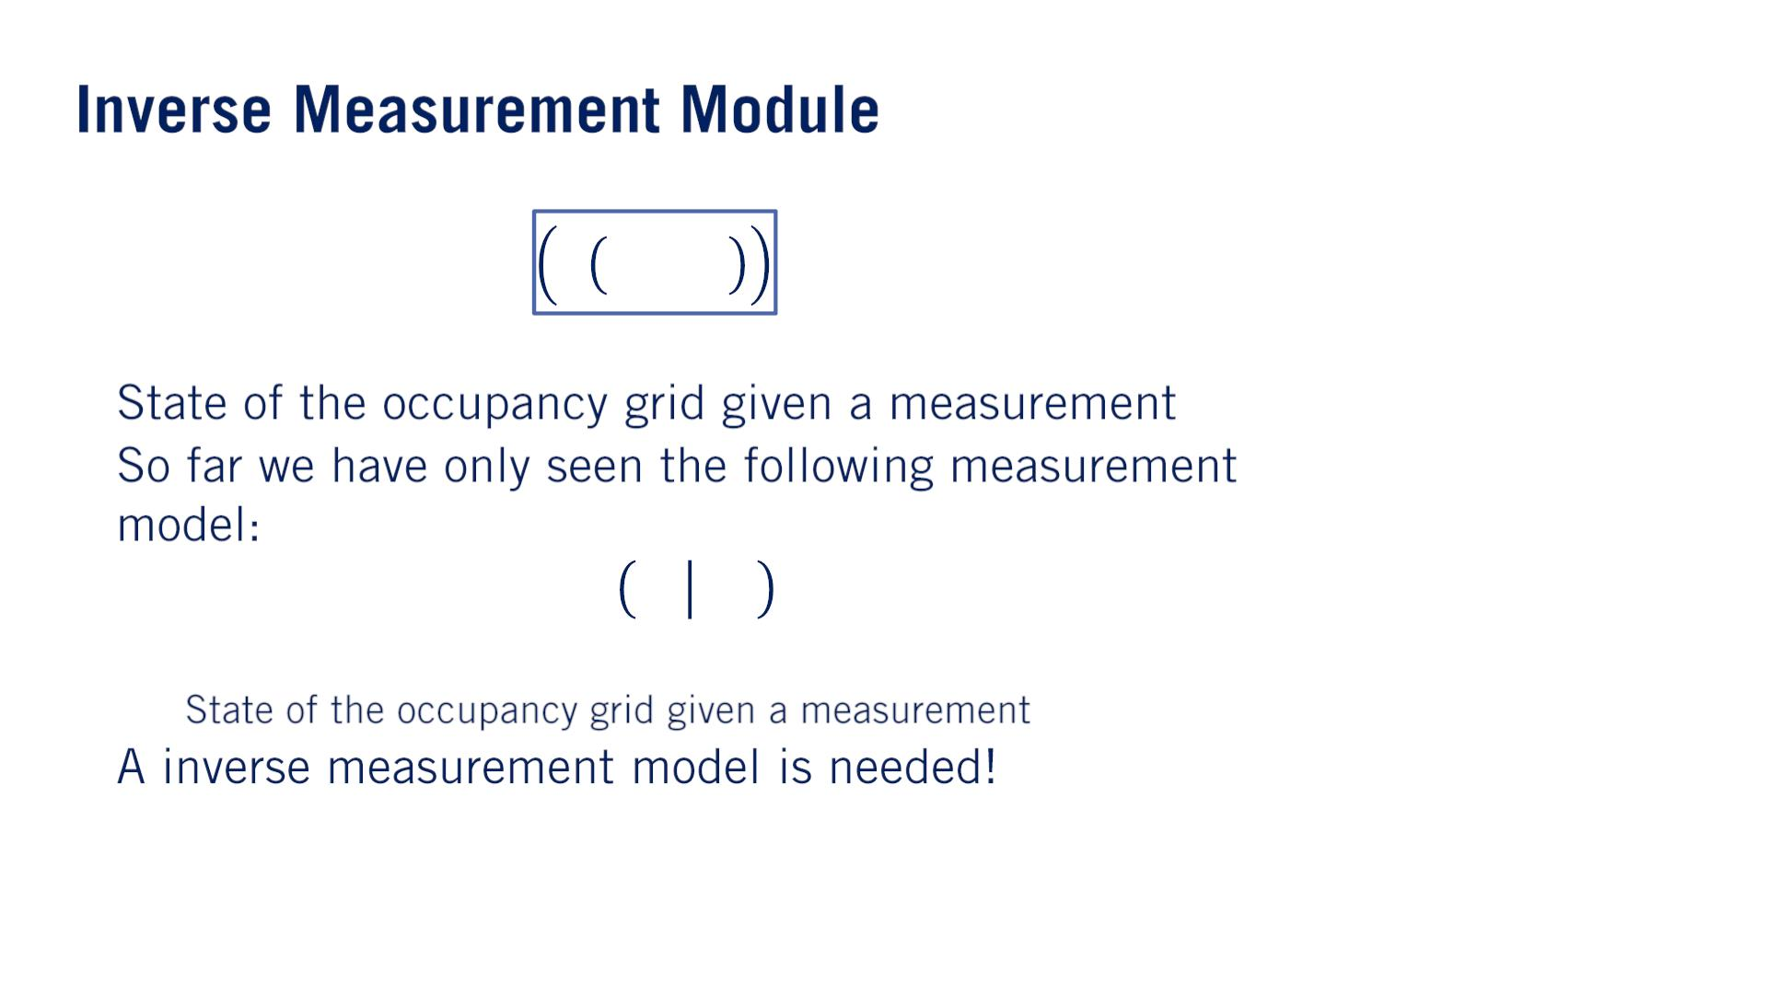
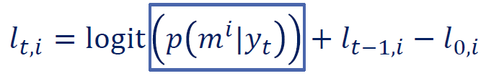
•
•
푝 푦 푚^{푖}
푡
o
•

Slide 27
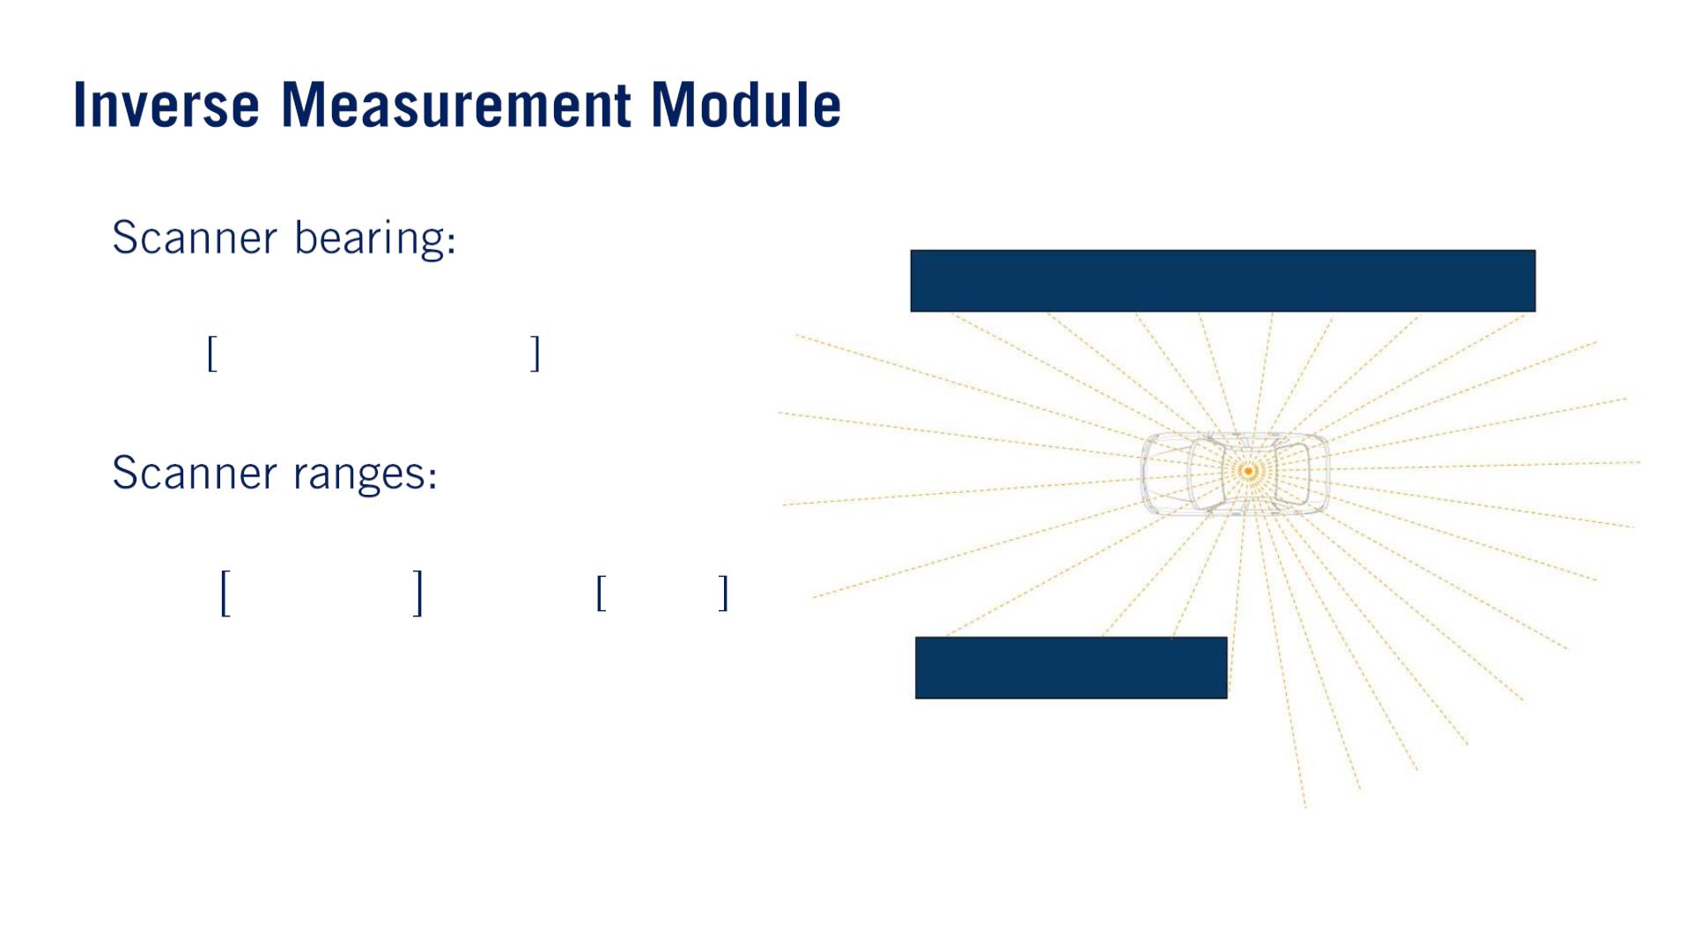
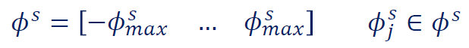
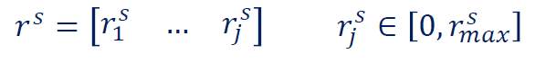
•
•
Most lidar today will also return a no echo signal, if a particular beam does not return an echo, indicating the absence of any object within range in that direction.
We will make an assumption here that the entire lidar scan measurements from a single rotation of the sensor is measured at the same instant in time.
本当は⾞の動きを考えてmeasurementsを調整しないといけない。

Slide 28
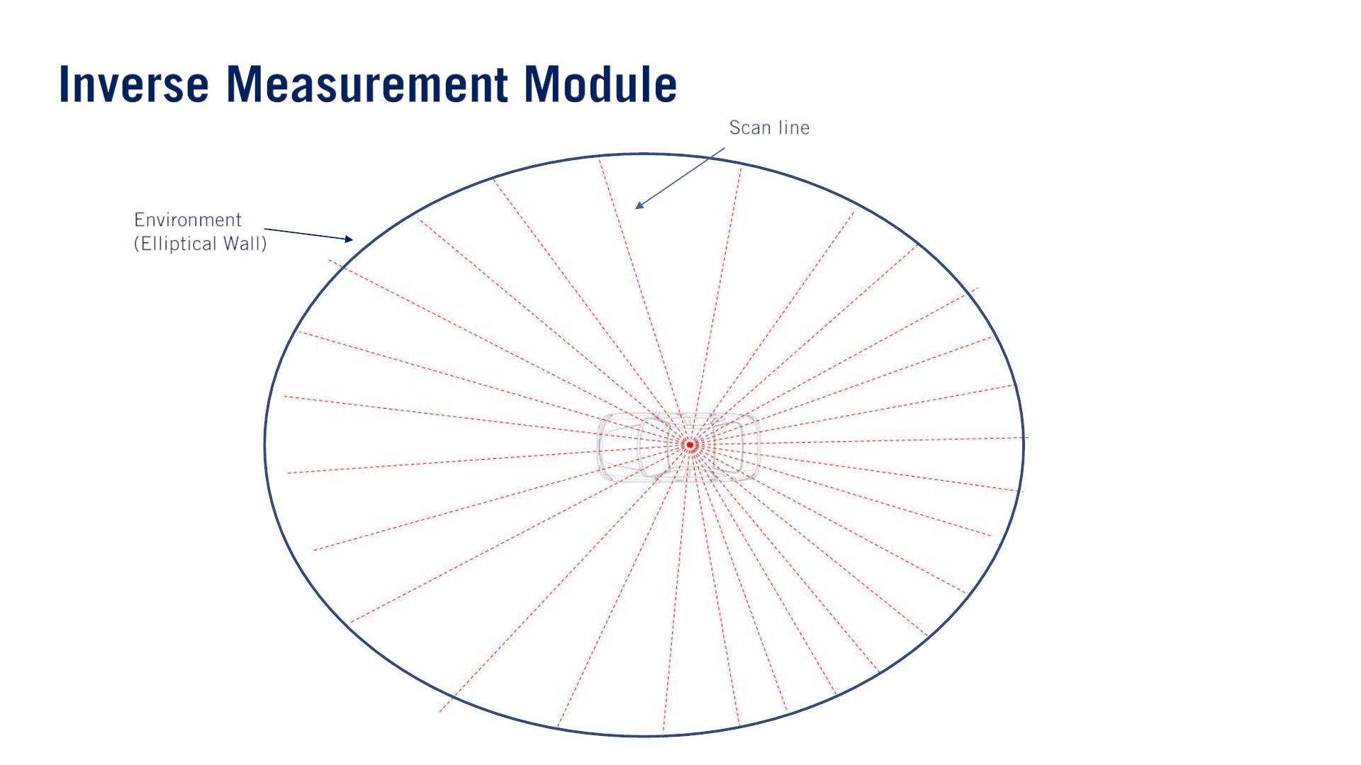
We construct a temporary occupancy grid that encompasses the maximum range of the beams in all directions.

Slide 29
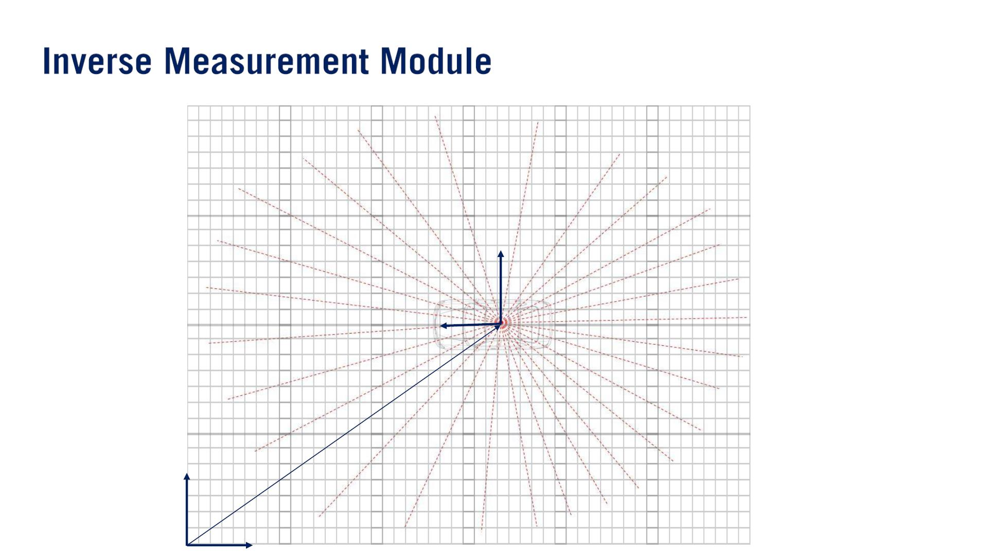
In practice, this occupancy grid frame is set to the vehicle frame and the map is transformed at each step based on our state estimates.
^{ℱ}푣푒ℎ푖푐푙푒
(푥 , 푦 , 휃 )
ℱ
1,푡 1,푡 1,푡
푚푎푝

Slide 30
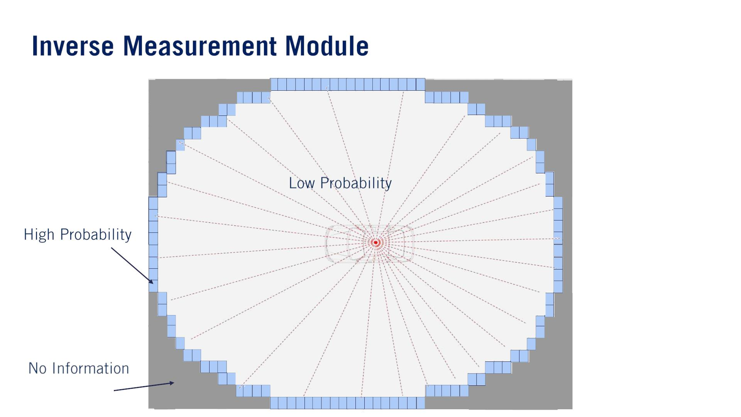
current LiDAR dataを基づいて、3つdistinct areas of the measurement grid.
No information.
None of the lidar beams had been able to reach.
Low probability.
all the beams have passed through this area without encountering anything.
High probability.
in which lidar has come into contact with an object and has returned a non maximum range value.

Slide 31
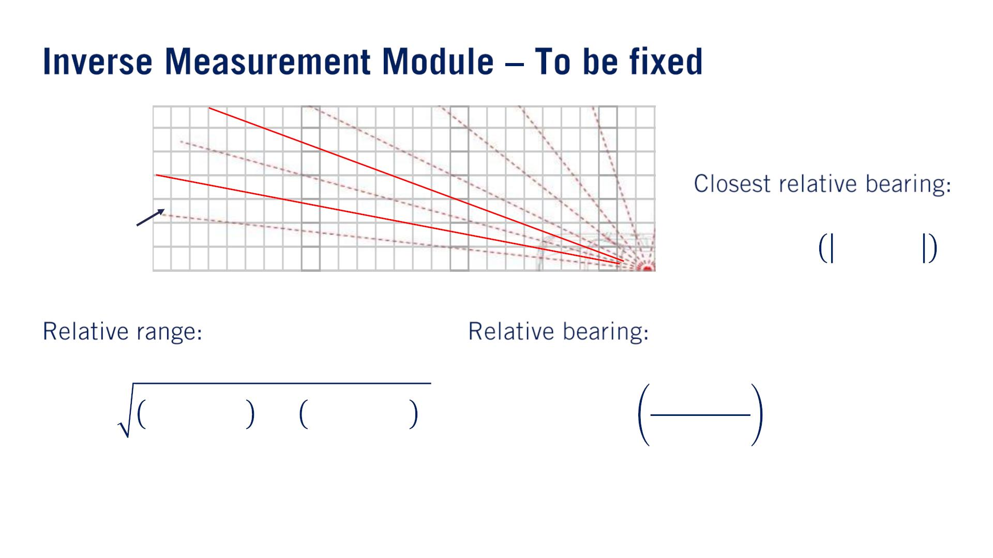
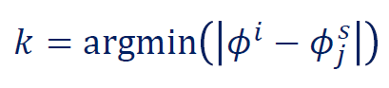



To translate these areas onto the measurement grid, each grid square will be assigned a range and bearing relative to the vehicle’s current location.
푖
푖
(푟 , 휙 )
１つのbeam（比較対象）と紐づくため
$x_{1,t}$, $x_{2,t}$ because vehicle’s current location changes.
$m_{x}^{i}$, $m_{y}^{i}$ are coordinates of the center of the grid cell.
$x_{3,t}$は車のyaw角だ

Slide 32

• 훂
• 휷
휷

Slide 33



このページの内容は講師が教えた内容と全然違うと思うので、直接に例へ進む。正しい内容は次の次のスライドへ。
•
•
푟^{푖} > min 푟^{푠}
푚푎푥
푠
푠
푟 < 푟
푚푎푥
푘
•
푠
푘
푟^{푖} < 푟

Slide 34


⼤体のやり⽅は簡単。lidarのmeasurement (red x)から$α,β$によって決まった範囲内にgridの中⼼があったら、このgridはHigh Probability.
⻆度が$β$範囲内だが、距離は$measurement−α/2$以下だったら、Low Probability.
•
휷
X

Slide 35

宿題にこれを実現する関数inverse_scannerがあって、正しい内容が⼊っている：
# If the range is greater than the maximum sensor range, or behind our range measurement, or is outside of the field of view of the sensor, then no new information is available.
$if\left(r>\min\left(rmax, meas_r\left[k\right]+\frac{α}{2}\right) || abs\left(φ−meas_φ\left[k\right]\right)>\frac{β}{2}\right)$:
$m\left[i,j\right]=0.5$
# If the range measurement lied within this cell, it is likely to be an object.
$elif meas_r\left[k\right]<rmax \&\& abs\left(r−meas_r\left[k\right]\right)<\frac{α}{2}$:
$m\left[i,j\right]=0.7$
# If the cell is in front of the range measurement, it is likely to be empty.
$elif r<meas_r[k]$:
$m\left[i,j\right]=0.3$

Slide 36

originally designed to efficiently solve the line plotting problem for displays and printing on the available hardware of the day.
•
•
o
o
o
o
By ray tracing along the beams of the lidar scan, we reduce the number of cells that need to be processed and identify them more quickly relying on integer addition, subtraction and bit shifting to move through the grid along the lidar beams.

Slide 37

•
•

Slide 38
宿題Programming Assessmentのお陰で、occupancy grid mapsを⽣成する4つステップに直感が できた！
get_ranges()
Gather range measurements of a moving car’s surroundings using a lidar scanning function.
これはlidarのmeasurementsを模擬している。結果はlidarの各⽅向（bearing）のrangeを返す。obstacleがあったら、obstacleまでの距離。obstacleがなかったら、max rangeを返す。
inverse_scanner()
Extract occupancy information from the range measurements using an inverse scanner model.
lidarのranges情報からoccupancy grid mapを作る。各grid cellにno information, high probability, low probabilityの3種類probabilityをつける。
Perform log odds updates on an occupancy grids based on incoming measurements.
log oddsで更新が便利なので。
Iteratively construct a probabilistic occupancy grid from those log odds updates.
log oddsからprobabilityに戻す。

Slide 39


Slide 40

•
o
o
o
単語
Concave: A surface that is concave inward in the middle.
Drainage: Drainage is the system or process by which water or other liquids are drained from a place.

Slide 41

センサーフュージョン研修のLidar Obstacle DetectionプロジェクトにDownsampling, Objects above car heightやGround planeの点群のFilteringはやった。
理由：make update operations run in real-time.
This drivable surface comes from the perception modules. コース３でSemantic Segmentationを利用してdrivable planeを予測していた。 3D座標は必要。
Voxel grid filteringをやっていた。
http://vml.sakura.ne.jp/koeda/PCL/tutorials/html/voxel_grid.html
これもrely on perception.
Semantic Segmentation利用できるでしょう

Slide 42

•
•
•
Downsamplingはavailable in Point Cloud Library and OpenCV.
Redundantの意味：Many of the generated points are actually redundant however due to the fact that there are many points that surround them capturing the same object information. In this example, we see a road sign that is densely covered in Lidar points where a small fraction of the points would suffice to indicate the location of the obstacle for Occupancy Grid Mapping.

Slide 43

•
This filter usually presumes a flat ground plane, and so should be aware that this is a dangerous assumption to apply blindly.
- accelerometerと同じような危なさ。

Slide 44

やる理由（⼤事）：If the ground plane is not removed, the occupancy grid might have artifacts which can result in deadlock in which the car cannot continue driving as it believes the roadway is blocked.
variable concavity for drainage; different slopes and bank angles; curvatures.
Due to the nature of the lidar scan, many of the concentric circles are due to the lidar scan hitting the drivable surface.
•
o
o
o
Curbs have different heights at different locations and road boundaries are not always clearly defined in lidar data.
parts of the curbs or non-drivable areas being removed as parts of the ground plane. 例えば歩道が消されら困る
The best approach to dealing with this sort of issue is to take advantage of vision, and deep neural networks through semantic segmentation!

Slide 45

The task then becomes a mapping of the drivable surface detected in the vision data to the lidar point cloud, masking out all those points that fall within the projected boundaries of the drivable surface.
•
•

Slide 46

Perception stack which must detect and track all dynamic objects in the scene.

Slide 47

The 3D bounding box of the detected dynamic object is used to remove all the points in the affected area.

Slide 48

Perceptionの⽅法はまだunsatisfactory.
•
•
解決：
つまりtrackingを利⽤。vehicleが⽌まっているかをチェック。
•
•
解決：
Rely on predictions of the moving objects’ motion based on their object tracks.
The bounding box is shifted forward along the predicted path, leading to a greater amount of the points of the dynamic object being removed from the most recent lidar scan.
removal処理のデータはいつも最新のlidar scan, dynamic objectの予測は以前のlidar scan ベース。

Slide 49

•
•
o

Slide 50

•
o
o
o
o
•
•

Slide 51


Slide 52

While a traditional map stores the approximate locations of roads, the High Definition Road Maps stores the precise road locations including all lanes down to a few centimeters accuracy.
また、the High Definition Road Maps store all of the locations of road signs and signals.

Slide 53

2014年の論⽂。OpenDriveよりは随分新しい！
Lanelet2: https://github.com/fzi-forschungszentrum-informatik/Lanelet2
for simple retrieval during motion planning tasks.
Due to this method’s effectiveness in storage and communication of the complex set of information needed for HD mapping, it is widely used. なのに、初めて聞いた！
This will play a key role in the behavior planning methods in particular.

Slide 54

boundaryって道路の？Laneの？
Laneのです：https://github.com/fzi-forschungszentrum-informatik/liblanelet
Boundaries of the lanelet are represented as the edges of the lanelet.
lane markingsもしくはcurbs.
•
•
Which affect the entirety of the lanelet.
such as speed limit.
such as whether this lanelet crosses another lanelet as in an intersection or merge.
o
o
▪
▪
o
区切りの設計
This means that a lanelet element can be as short as only a few meters in the case of a lanelet, which is part of an intersection, or can be hundreds of meters long for a highway road segment.
Which come at the end of the lanelet.
Represented as lines which are defined by a set of co-linear points.
Regulation elements usually require an action or decision to be made.
例えば、Stop line, Traffic lights line, Pedestrian crossings.
that might be present at the end of the lanelet element, such as a stop sign line or a static sign line.
Note that we only store a line for any regulatory element as this is the point that the autonomous vehicle treats as the active location for that regulatory element.

Slide 55

Lane boundaries are stored as a set of points creating a continuous polygonal line.
The distance between points can be as fine as a few centimeters, or as coarse as a few meters depending on the smoothness of the polyline in question.
間隔は⼀定じゃなくてもいい。
The ordering of the points defines the direction of travel and heading for the lanelet.
⽩線点列の順番はここも⼤事ですね！
•
•
o
•
o
o
o
A center line between the two boundaries can be interpolated, which can be used as the desired path of travel for the autonomous vehicle in that lane.
Basepath点列は特に要らない。⼤事なのは両側境界線点列。しかし、2⾞線の場合、重複の点列を保存するようですね。いや、点列の順番がレーンの進行方向になるので、同じ白線でも、違うレーンには違う逆順番で保存する必要があるかもしれない。

Slide 56

•
•
o
o
o
o
o

Slide 57

Each lanelet has 4 possible connections: 左右前後。
The entire lanelet structure is connected in a directed graph, which is the base structure of the HD map.
3
5
2
4
1

Slide 58

•
•

Slide 59

•
•
•

Slide 60

•
o
o
o

Slide 61

•
•
o
o
o
•
•
•

Slide 62

Additional slides

Slide 63

Laneletを習得！

